Slide 1
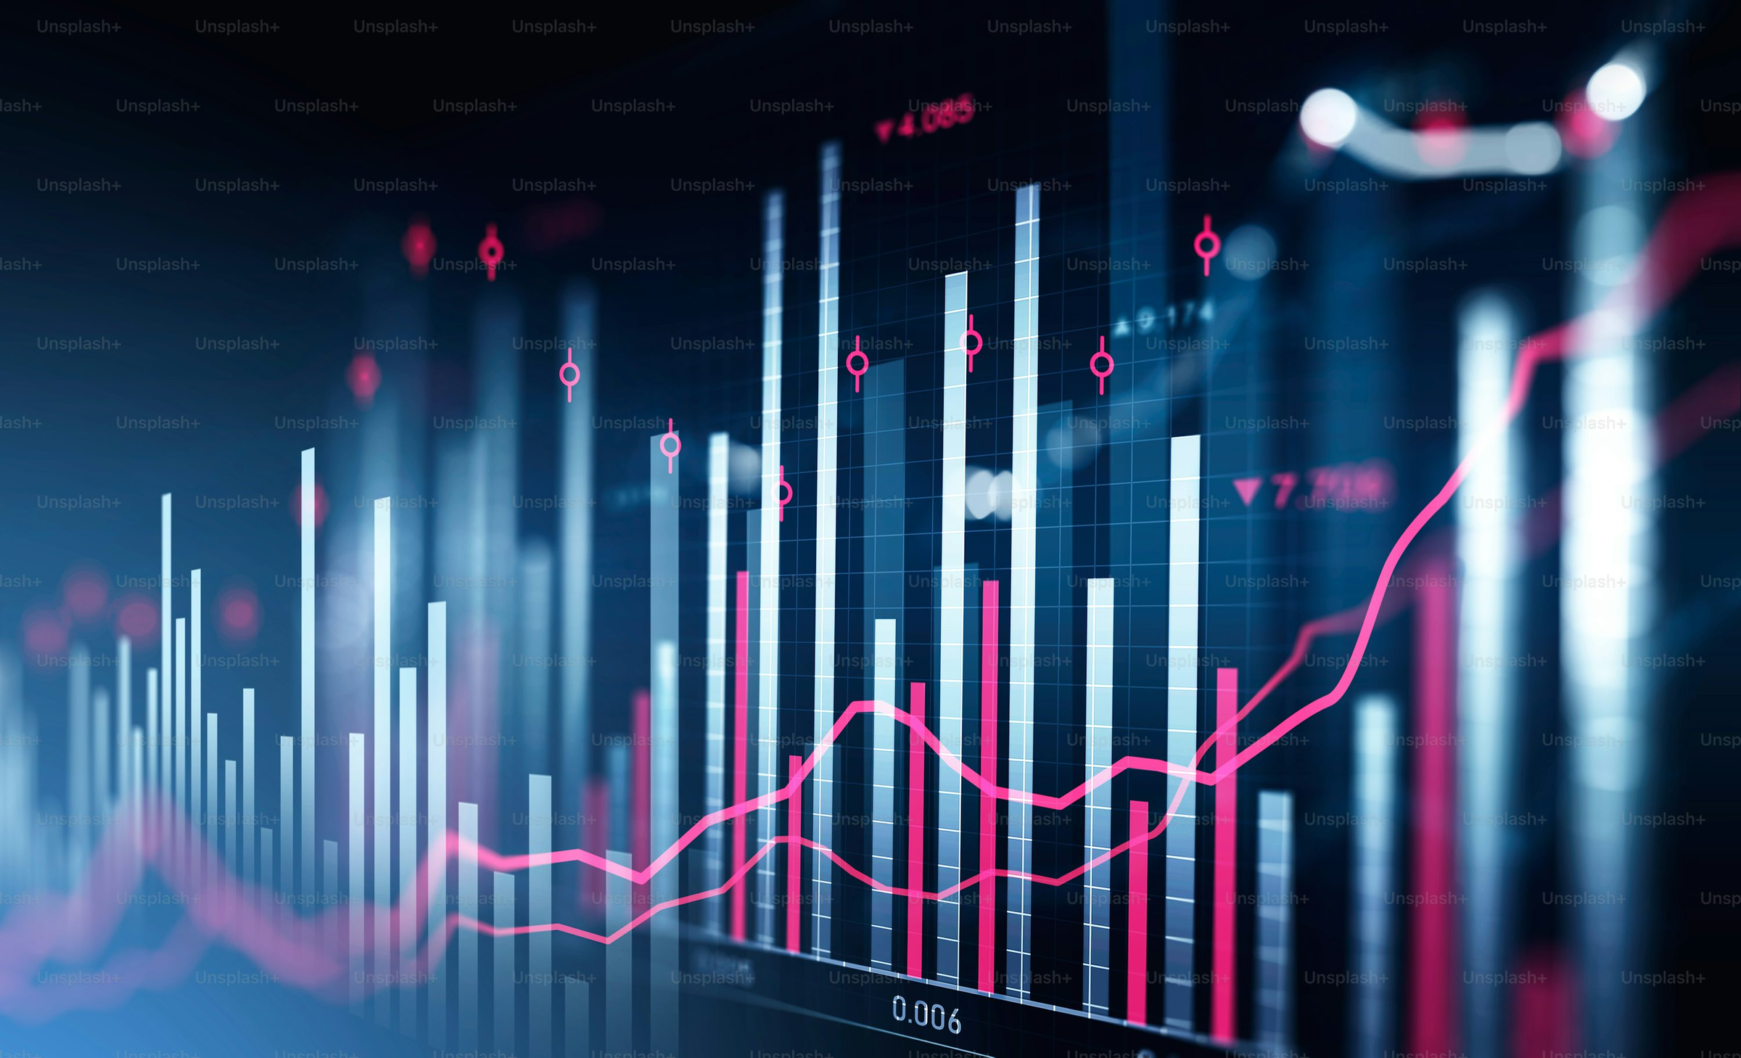


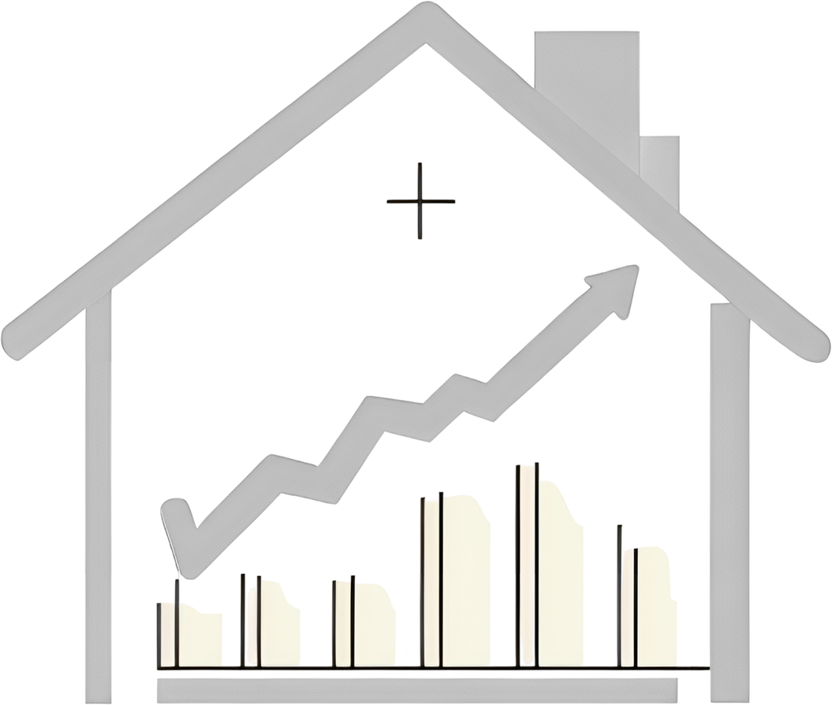




HOUSE PR CE
PREDICTION
USING
MACHINE LEARNING

Slide 2


Presented By -
Khatik Uttam
Saumil Jani
Dipak Raval
Sandhya
Sagiraju Sreeja
Payal Prajapati
Krisha Shah
Barad Anjali
9. Rutika Patil
10. Aryan Prasad
11. Rudra Buch
12. Mudaliar Krishnan
13. Dev Manghani
14. Jenil Sanchaniya
15. Malav Mori
16. Raj Singh
Guided by:
Asst. Prof. A.N.Mishra

Slide 3


Outline
Introduction to AI
Introduction to ML
Tkinter & Data Pre-Processing
Functions Used
Problem Statement
Tools & Libraries Used
Column Name & Data types
Model Evaluation
Visualization
Training Set & Testing Set
Graphical User Interface (GUI)
Conclusion

Slide 4
Introduction to AI
Artificial Intelligence (AI) is a computer science field focused on creating systems that perform tasks requiring human-like intelligence, including learning, reasoning, problem-solving, perception, and natural language processing.
AI is categorized into three types:
Weak AI: Task-specific, limited context, no general cognitive abilities (e.g., facial recognition, self-driving cars).
Strong AI: Advanced AI that can reason, plan, and solve problems like a human.
Super AI: Theoretical AI that exceeds human intelligence in all areas, including creativity and emotional intelligence, with self-awareness and autonomy.

Slide 5
Key Areas of AI:
Machine Learning (ML): A subset of AI where machines learn patterns and make decisions based on data, without being explicitly programmed. It includes algorithms like supervised learning, unsupervised learning, and reinforcement learning.
Natural Language Processing (NLP): This involves the interaction between computers and human language. NLP allows machines to understand, interpret, and generate human language, as seen in applications like chatbots, translation services, and voice assistants.
Computer Vision: Enabling machines to interpret and process visual information from the world, such as identifying objects, recognizing faces, and understanding scenes.
Robotics: The design and creation of robots that can perform tasks autonomously, often incorporating AI to enhance decision-making and adaptability.

Slide 6
Applications of AI:
Healthcare: AI can assist in diagnosing diseases, personalizing treatment plans, and improving patient care.
Finance: AI is used for fraud detection, risk management, and algorithmic trading.
Automotive: Autonomous vehicles rely on AI to make real-time decisions, improving road safety and efficiency.
Entertainment: AI is used for personalized recommendations in music, movies, and online content.

Slide 7
Introduction to ML
Machine Learning (ML), a subset of Artificial Intelligence (AI), allows computers to learn from data, make predictions, and improve performance without explicit programming. It automates tasks, analyzes large datasets, and enhances decision-making across various fields, including:
Healthcare: Disease prediction and medical diagnosis
Finance: Fraud detection and risk analysis
E-commerce: Personalized recommendations
Self-driving Cars: Object detection and accident prevention
Speech & Image Recognition: Virtual assistants and face detection
Cybersecurity: Malware and network threat detection
Robotics: Smart automation
Applications of Machine Learning (ML):

Slide 8
Types of Machine Learning (ML)
Supervised Learning :
The model learns from labeled data, where each input has a known output.
It makes predictions based on past examples.
Example: In spam detection, the model learns from emails labeled as "spam" or "not spam" to classify new emails correctly.
2. Unsupervised Learning
The model works with unlabeled data and finds patterns or groupings on its own.
It is used for clustering, anomaly detection, and association rule learning.
Example: In customer segmentation, ML groups customers based on similar buying behaviors without predefined labels.
3. Reinforcement Learning
The model learns by interacting with an environment and receiving rewards or penalties.
It improves over time by maximizing rewards through trial and error.
Example: A self-driving car learns to navigate roads by adjusting its actions based on successful or failed maneuvers.

Slide 9
Linear Regression
Linear Regression is a popular supervised learning algorithm for predicting continuous values by establishing a relationship between an independent variable (X) and a dependent variable (Y). The equation is Y = mX + c, where m is the slope and c is the intercept.
Example: Predicting house prices based on square footage.
Applications :
House Price Prediction
Sales Forecasting
Stock Market Prediction
Healthcare (Disease Progression)
Salary Prediction
Weather Forecasting

Slide 10
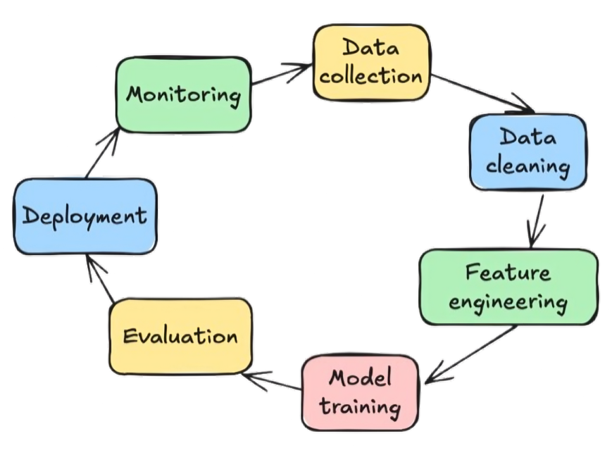
Step-by-Step Process :

Slide 11
Data Pre-Processing
Data preprocessing in Machine Learning involves cleaning and transforming raw data for effective use by ML models.
It's essential due to the common issues of incomplete, inconsistent, and noisy real-world data.
Steps in Data Preprocessing:
Raw Data is collected from various sources and is often unstructured.
Structured Data is organized into formats such as tables or CSV for easier processing.
Data Preprocessing includes cleaning, handling missing values, normalizing, encoding, and feature selection.
Exploratory Data Analysis (EDA) examines distributions, correlations, and patterns.
Insight Reports summarize key findings and trends.
Visual Graphs present data insights using histograms, scatter plots, and heatmaps.

Slide 12
Functions used
head() Function:
Displays the first 5 rows of the dataset.
Helps understand the dataset's structure and feature data types.
tail() Function:
Displays the last 5 rows of the dataset.
Useful for identifying patterns or issues at the end of the dataset, such as missing values.
isnull() Function:
Checks for NaN cells, identifies rows/columns with missing data for cleaning.
dropna() Function:
Removes rows/columns with missing values, ensuring a clean dataset.
info() Function:
Summarizes the dataset, showing non-null counts, data types, and memory usage, helping identify missing values and necessary conversions.

Slide 13

Problem Statement
The real estate market is an essential part of the economy, and house prices are influenced by various factors such as location, square footage, number of bedrooms, age of the property, and many more. Accurately predicting house prices is crucial for buyers, sellers, investors, and real estate agents to make informed decisions.
This project aims to build a Machine Learning model that can predict house prices based on various features, such as:
Size of the house (in square feet)
Location/Neighborhood
Number of bedrooms and bathrooms
Age of the property
Proximity to amenities (e.g., schools, parks, public transport)
Other factors like the condition of the house, type of house, etc.

Slide 14
Objective:
To create a predictive model using machine learning algorithms to estimate the price of a house based on these influencing factors.
To evaluate the model's performance and determine the most significant features that impact house pricing.
By successfully predicting house prices, this project can help individuals and organizations in the real estate industry make better decisions, optimize pricing strategies, and improve market predictions.

Slide 15


Tools Used
PYTHON 3.13
JUYPTER NOTEBOOK

Slide 16
Libraries
1.Pandas: For data loading, cleaning, and manipulation. It provides powerful data structures like DataFrame for handling structured data.
Example: import pandas as pd
2.NumPy: For numerical operations and handling arrays, which can be useful for data transformations or mathematical calculations.
Example: import numpy as np

Slide 17
3.Matplotlib: For creating static, animated, and interactive visualizations (like scatter plots, histograms, and bar charts).
Example: import matplotlib.pyplot as plt
4.Seaborn: For statistical data visualization, offering more advanced visualization options than Matplotlib.
Example: import seaborn as sns
5.Scikit-learn: For implementing machine learning algorithms like linear regression, decision trees, random forests, support vector machines, etc., and performing model evaluation.
Example: from sklearn.model_selection import train_test_split (for splitting data into training and testing sets)
from sklearn.linear_model import LinearRegression (for linear regression).

Slide 18
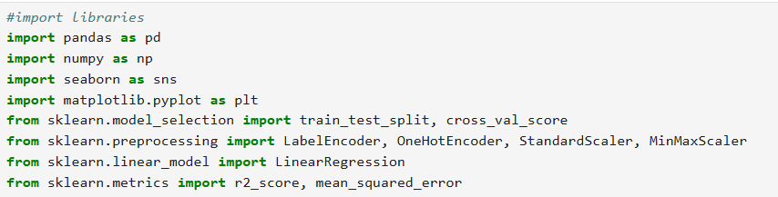

Slide 19
Data Collection Sources
For our house price prediction project, we used the Bengaluru House Price Prediction dataset, which was sourced from Kaggle. This dataset contains detailed information about various houses in Bengaluru, including features like location, size, number of bedrooms, and more. It was selected for its comprehensive nature and relevance to predicting house prices in urban areas.
You can access the dataset and more details from Kaggle:
https://www.kaggle.com/

Slide 20
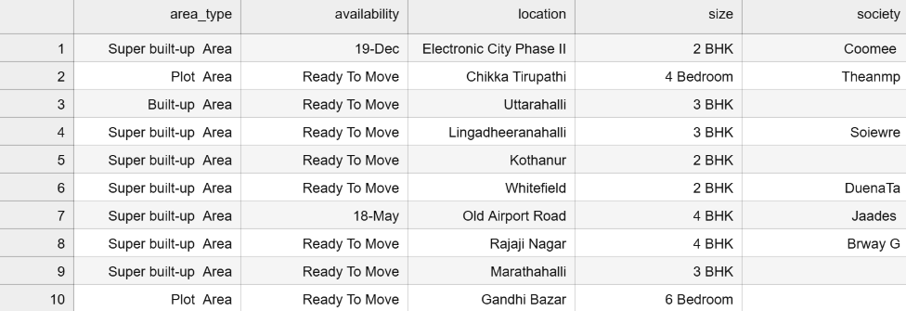
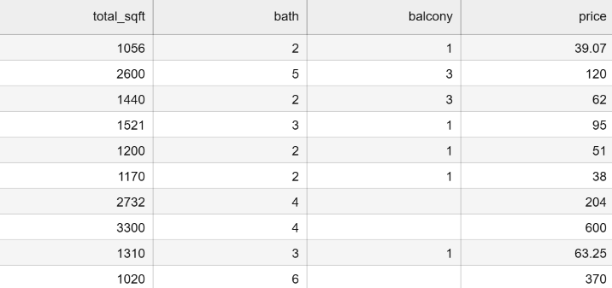
Column Name And Type

Slide 21
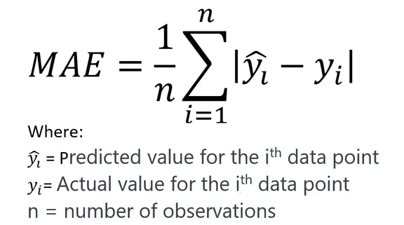




Model Evaluation
Model evaluation is essential in machine learning for assessing a predictive model's performance on unseen data. In our house price prediction project, we utilize various metrics to measure the model's accuracy and effectiveness.
1.Key Model Evaluation Metrics
A. Mean Absolute Error (MAE)
Measures the average absolute difference between predicted and actual values.
Lower values indicate better model performance..
Formula:

Slide 22
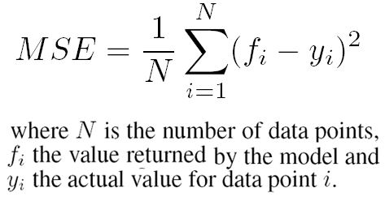
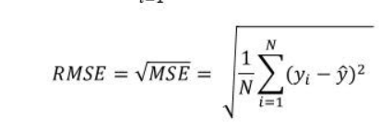
B. Mean Squared Error (MSE)
Similar to MAE but squares the errors, giving more weight to larger errors.
Helps in identifying models with large prediction errors.
Formula :
C. Root Mean Squared Error (RMSE)
The square root of MSE, making it more interpretable in the context of the original dataset.
Lower RMSE values indicate better accuracy.
Formula :

Slide 23
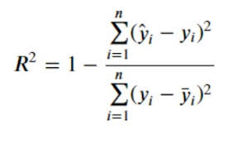
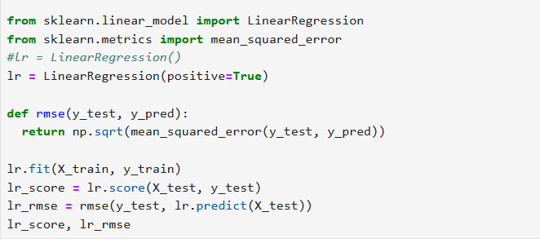
D. R-Squared (R²) Score
Represents the proportion of variance in the dependent variable that is predictable from the independent variables.​
Values range from 0 to 1, where 1 indicates perfect predictions.
Formula :

Slide 24
2. Model Validation Techniques
A. Train-Test Split
The dataset is divided into training (80%) and testing (20%) sets.
The model is trained on the training data and evaluated on the test data.
B. Cross-Validation (K-Fold)
The dataset is split into K subsets, and the model is trained on K-1 subsets while testing on the remaining one.
Reduces bias and improves model generalization.
3. Model Performance Interpretation
If MAE, MSE, and RMSE are low, the model is performing well.
If R² is close to 1, the model explains most of the variance in house prices.
If error metrics are high, the model might be underfitting or overfitting.

Slide 25
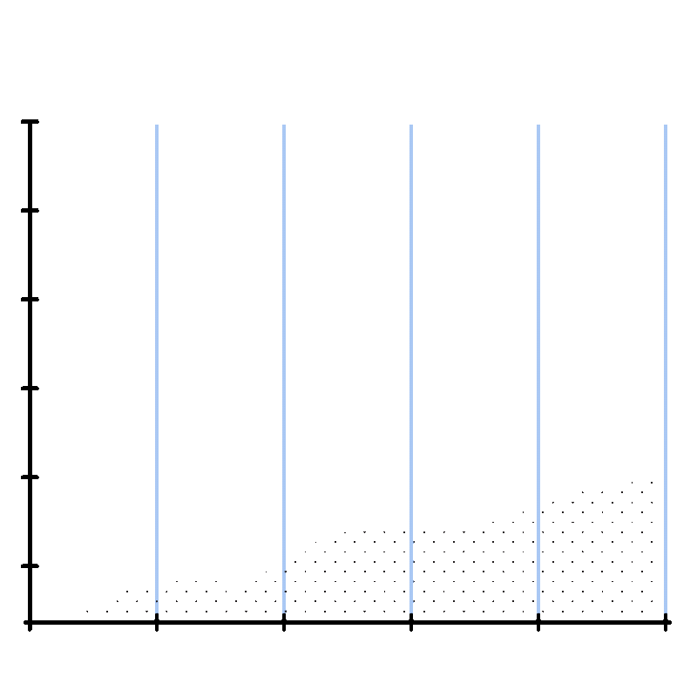
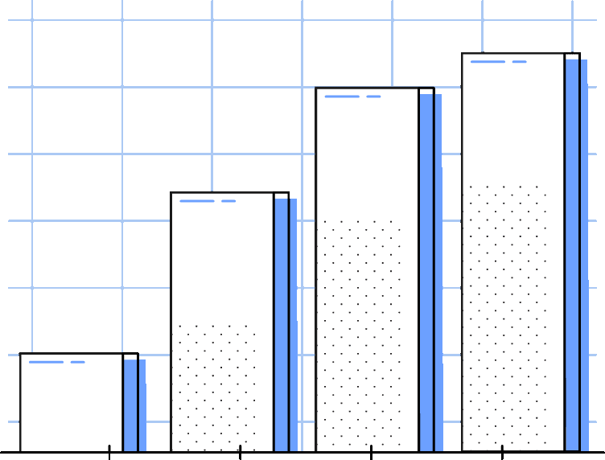
Visualization
Visualization is crucial in data analysis and machine learning because it helps to understand patterns, detect outliers, and communicate insights effectively.
Importance
Understanding Data Distribution – Identifies price skewness and spread using histograms & KDE plots.
Detecting Outliers – Box plots reveal extreme values that impact model accuracy.
Feature Relationships – Scatter plots & heatmaps show how size, location, and BHK influence price.
Model Evaluation – Training vs. testing data comparison ensures balanced learning.
Future Insights – Helps predict trends, aiding buyers, sellers, and investors.

Slide 26
2. Types of Plots:
(i) Histogram (Histoplot)
A histogram is used to show the distribution of a dataset by representing how frequently different ranges of values (bins) occur.
The x-axis represents the values (e.g., house prices), divided into intervals (bins).
The y-axis shows the frequency of data points within each bin.
The height of each bar indicates how many data points fall within that range.
Histograms are helpful for identifying the overall distribution, patterns (like peaks and gaps), and characteristics such as skewness or outliers in the data.

Slide 27
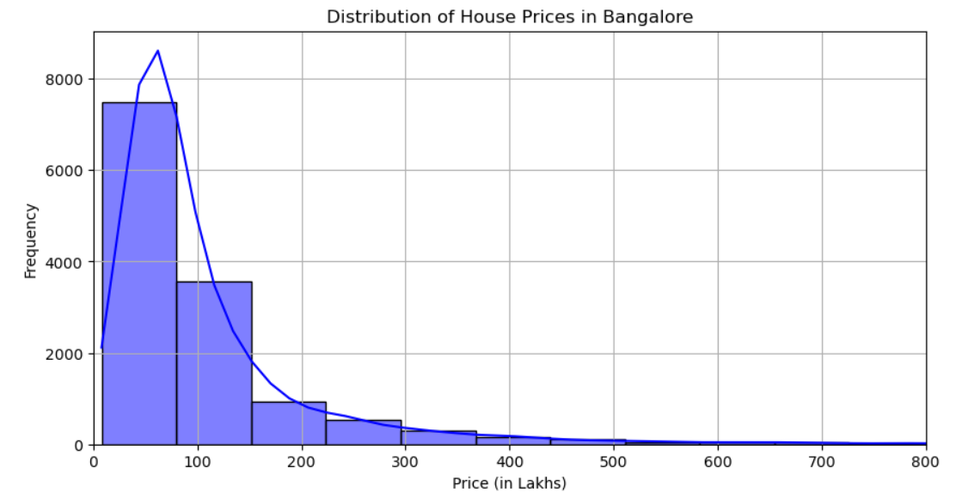

Slide 28
The graph titled "Distribution of House Prices in Bangalore" illustrates the spread of house prices across various price ranges.
X-Axis: House prices in Lakhs (0-800 Lakhs).
Y-Axis: Frequency of houses at various price points.
Bars: Blue bars indicate the number of houses in specific price ranges, with the highest bar showing most houses in the lower range.
Curve: A blue KDE curve overlays the histogram, illustrating price distribution trends.
Key Insights:
Right-skewed distribution: Most houses are priced low (0-100 Lakhs).
Majority are affordable, with the most common price range below 100 Lakhs.
Luxury homes (above 200 Lakhs) are rare.
The market mainly features affordable to mid-range homes.
Conclusion:
The graph highlights housing affordability and availability, indicating that most buyers will find options in lower price ranges, while higher-priced properties are limited, which is valuable for investors, home buyers, and market analysts.

Slide 29
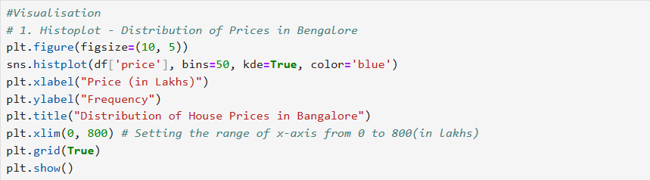
Code:

Slide 30
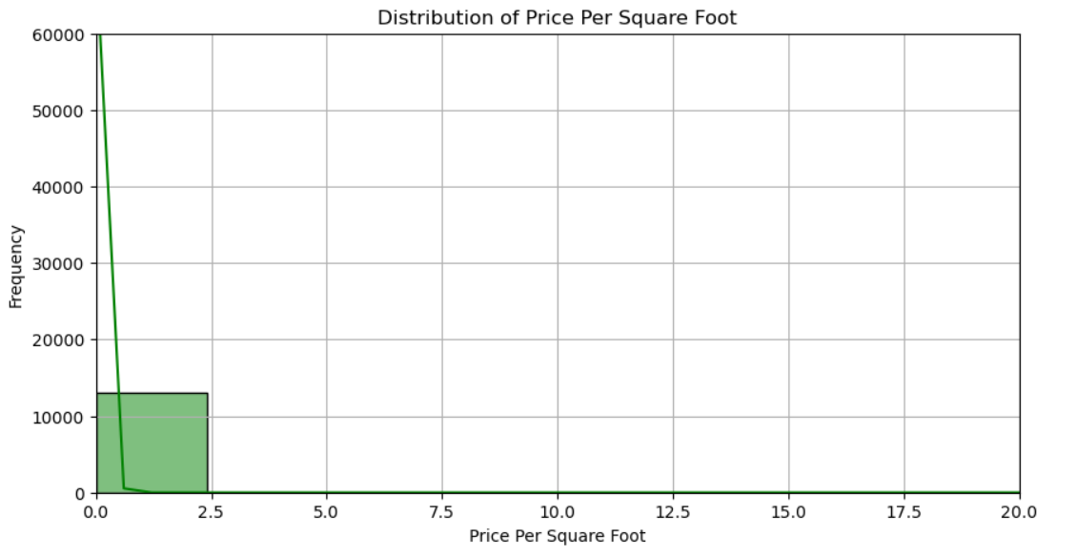

Slide 31
This graph illustrates the distribution of price per square foot for properties. Here's a breakdown for presentation:
X-axis: Price per square foot (0 to 20).
Y-axis: Frequency of properties in each price range.
Interpretation
Histogram (green bars) shows property counts in price brackets.
Green curve indicates the density of distribution.
Most data is concentrated in the low price range, with a skew towards higher prices.
Key Observations:
Sharp peak indicates many properties are priced low.
Long tail suggests rare high-priced properties.
Most values cluster below 2.5, with high prices as outliers.
Conclusion:
This distribution is typical in real estate, where most properties are affordable, with few expensive ones likely linked to premium locations or unique features.

Slide 32
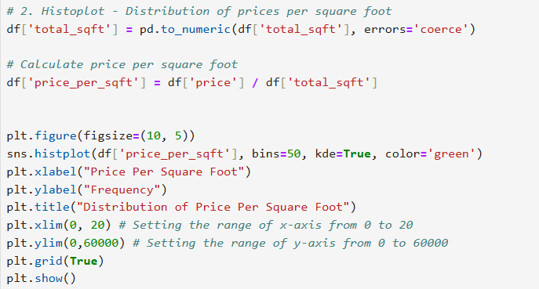

Slide 33
(ii) Scatter Plot
A scatter plot is used to display the relationship between two continuous variables.
The x-axis and y-axis represent the two continuous variables being compared (e.g., square footage vs. house price).
Each point represents a pair of values, with its position based on the values of the two variables.
Usage:
Scatter plots are useful for identifying correlations (positive, negative, or no correlation) between variables.
They also help detect outliers and trends, such as whether an increase in one variable is associated with an increase or decrease in the other.

Slide 34
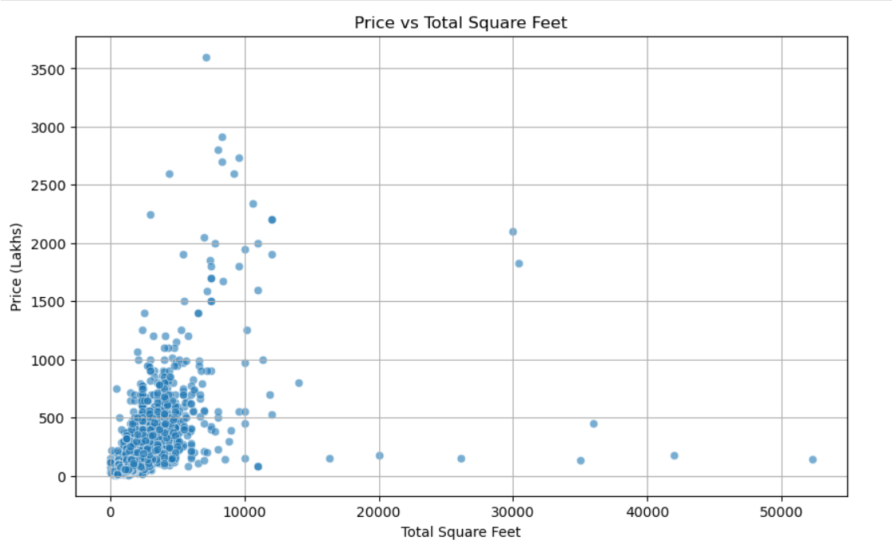

Slide 35
This scatter plot illustrates the relationship between house prices and size (total square feet).
Graph Overview:
X-Axis: Size of the house in square feet.
Y-Axis: Price of the house in Lakhs.Each blue dot represents a house, indicating its price and size.
Key Observations:
Most Houses in Lower Range: Most houses are found in the lower left corner, indicating smaller sizes (under 10,000 sq. ft.) and prices below 500 Lakhs.
Price and Size Relationship: Generally, larger houses have higher prices, but the relationship isn’t linear; some smaller houses are pricey, while some larger ones are cheaper.
Outliers: A few very large houses (30,000+ sq. ft.) have high prices, but some are not as costly as expected.
Conclusions:
Bigger houses usually cost more, but price is influenced by other factors like location and amenities.
Some luxury homes may be expensive despite smaller sizes due to prime locations, while larger homes might be less expensive due to various factors.

Slide 36
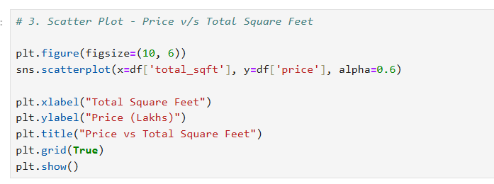

Slide 37
(iii) Box plot
A box plot (also known as a box-and-whisker plot) provides a graphical summary of the distribution of a dataset, showing key statistical features like the median, quartiles, and outliers.
The box represents the interquartile range (IQR), with the lower and upper edges showing the 25th and 75th percentiles (Q1 and Q3).
The line inside the box represents the median (50th percentile) of the dataset.
The whiskers extend from the box to the smallest and largest data points within 1.5 times the IQR.
Outliers are represented as individual points beyond the whiskers.
Usage:
Box plots are great for summarizing data, detecting outliers, and comparing distributions across different categories (e.g., comparing house prices across different cities).

Slide 38
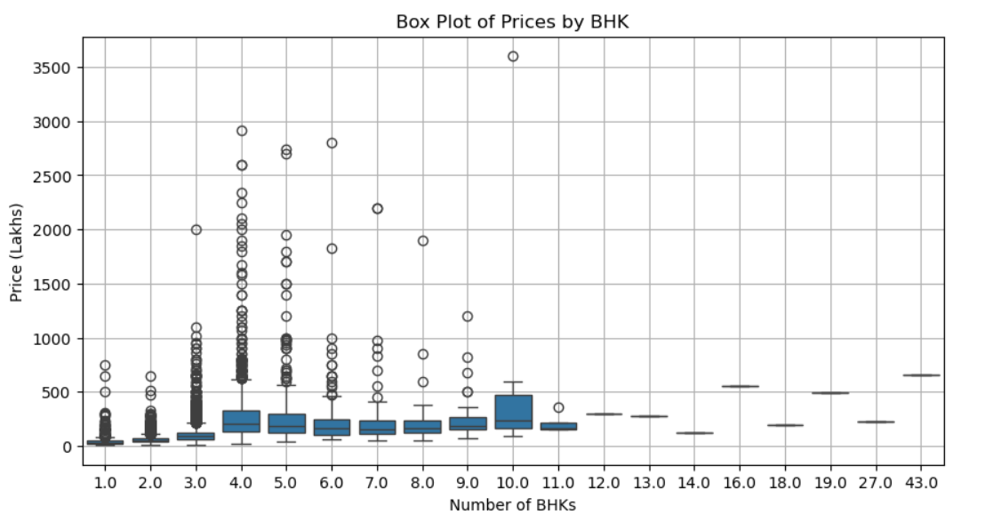


Slide 39
This box plot visualizes property prices based on different BHK (Bedroom-Hall-Kitchen) configurations:
Graph Overview:
X-axis: Number of BHKs
Y-axis: Price (in Lakhs)
Components of a Box Plot:
Bottom whisker: Minimum price (excluding outliers)
Bottom edge: 25th percentile (Q1)
Median line: 50th percentile (Q2)
Top edge: 75th percentile (Q3)
Top whisker: Maximum price (excluding outliers)
Dots outside whiskers: Outliers
Key Observations:
Trend: Median prices rise with more BHKs, as larger properties are generally pricier.
Price Variation: 1-5 BHK prices are consistent, while 6+ BHKs show greater price variability.
Outliers: Many expensive smaller properties exist; extremely high BHK values (16, 18, 27, 43) have few data points.
Conclusion:
Most properties have 1-5 BHKs.
Larger properties show wider price ranges due to factors like luxury features and location.
Outliers indicate some premium properties significantly exceed typical prices.

Slide 40
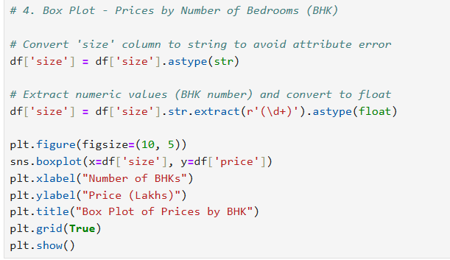

Slide 41
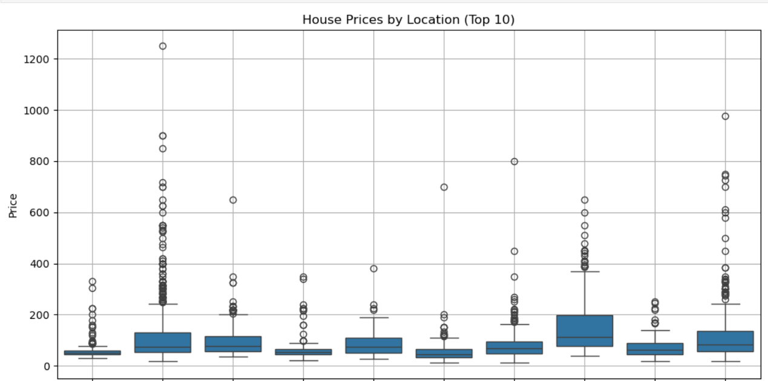
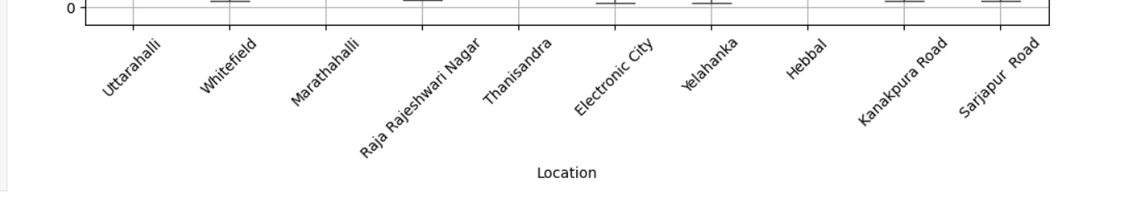

Slide 42
This box plot visualizes house prices across the top 10 locations, making it easy to understand price distribution.
Graph Overview:
X-axis: top 10 locations
Y-axis: house prices.
Each box plot represents price distribution per location.
Components of a Box Plot:
Bottom whisker: lowest price (excluding outliers).
Bottom edge: 25th percentile (Q1).
Middle line: median price (Q2).
Top edge: 75th percentile (Q3).
Top whisker: highest price (excluding outliers).
Dots outside whiskers: outliers (significantly higher prices).
Key Observations
Price Variation:Wider boxes indicate more price range; narrower boxes suggest consistency.
Median Prices:Higher median indicates more expensive areas; lower median suggests affordability.
Outliers: Many outliers highlight significantly expensive homes, with some exceeding 1000 Lakhs.
Conclusion:
The box plot aids in comparing house price distributions.
Wider spreads indicate diverse pricing; outliers suggest luxury properties.
Useful for buyers, sellers, and investors to grasp pricing trends.

Slide 43
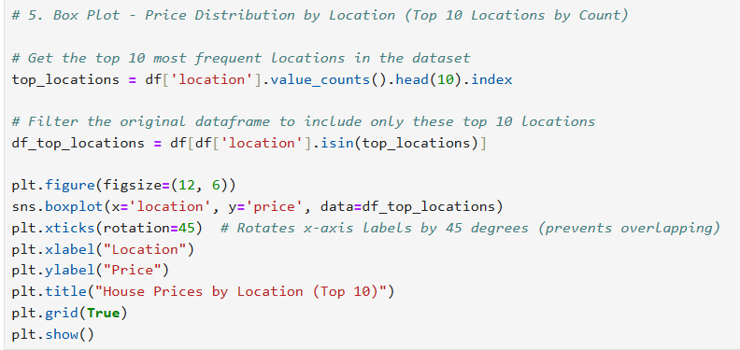

Slide 44
(iv) Residual Plot
A residual plot is used to assess how well a model fits the data, specifically looking at the residuals (the differences between observed values and predicted values).
The x-axis represents the predicted values from the model (e.g., predicted house prices).
The y-axis represents the residuals (the differences between the actual and predicted values).
Each point represents one data point, plotted based on its predicted value and residual.
Usage:
Residual plots are important for diagnosing issues with regression models. A random scatter of residuals around zero suggests a good model fit, while patterns in the plot (e.g., curvature or clustering) suggest model problems like non-linearity or heteroscedasticity.

Slide 45
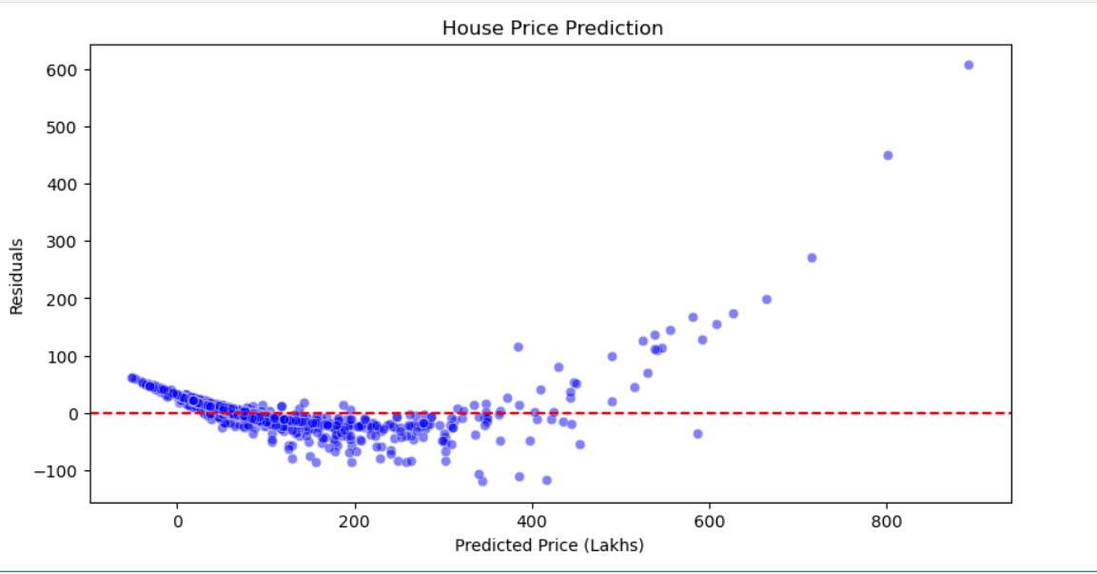

Slide 46
This Residual Plot for House Price Prediction evaluates model performance:
Graph Overview:
X-axis: Predicted house prices (in Lakhs).
Y-axis: Residuals (Actual price - Predicted price).
Blue dots represent houses; the red dashed line indicates zero error.
Understanding Residuals:
Residuals indicate prediction accuracy.
Above the red line: model underestimated price.
Below the red line: model overestimated price.
Ideally, residuals should be randomly scattered near the red line.
Key Observations:
Low Prices: Residuals are near zero, indicating good model performance.
High Prices: Increased variability; model struggles with expensive houses.
Curved Pattern: Suggests non-linearity, indicating the need for model enhancements.
Conclusion:
The model predicts low to mid-range house prices well but needs improvement for high-end properties. The curved pattern suggests further refinement is necessary.

Slide 47
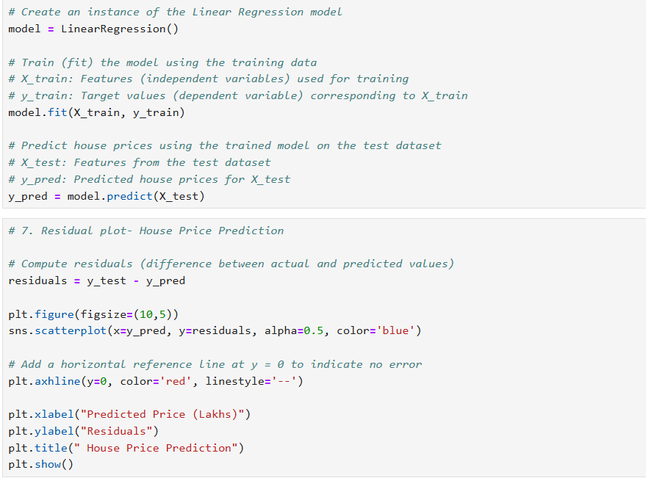

Slide 48
Training Set
What is a Training Set?
A training set is a collection of labeled data used to teach a machine learning model how to make predictions. In this case, the model learns to predict house prices based on past sales data.
It contains real estate data used to train a machine learning model. It includes various factors (features) that influence house prices.
The training set helps the model learn patterns in house prices.
The trained model can predict prices for new properties.

Slide 49
How is the Training Set Used?
Data Preprocessing
Remove missing values.
Convert categorical data (like location) into numbers (label encoding, one-hot encoding).
Normalize numerical values (scaling).
Feature Selection
Choose the most important factors (e.g., size, location, square footage).

Slide 50
3.Train the Model
Split data into training (80%) and testing (20%) sets.
Train the model using algorithms like:
Linear Regression (Simple & interpretable)
Decision Trees (Handles complex relationships)
4. Make Predictions
The model learns from the training set and predicts prices for new houses.

Slide 51
Test Set
What is the Test Set?
The test set is used to evaluate how well the model predicts house prices.
It is separate from the training set to check accuracy.
Helps measure the model’s generalization ability on unseen data.
The test set ensures the model predicts house prices accurately.
It contains real house data (not seen during training).

Slide 52
The test set is used in the following ways:
Dataset Splitting:
Training Set: 80% of data for learning.
Test Set: 20% of data for evaluation.
Evaluation Metrics:
Mean Absolute Error (MAE): Average absolute difference between actual and predicted prices.
Mean Squared Error (MSE): Average squared difference, penalizing larger errors.

Slide 53
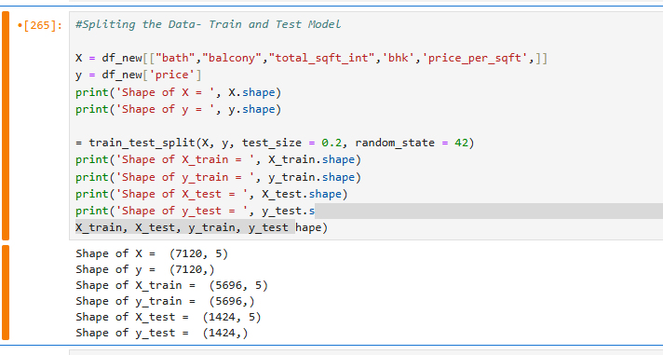

Slide 54
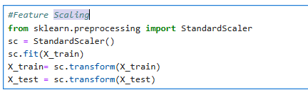

Slide 55
Graphical User Inteface
A Graphical User Interface (GUI) is a visual way for users to interact with an application.
Instead of using text commands, users can interact through buttons, input fields, and graphical elements.
In a House Price Prediction system, a GUI makes it easier for users to input house details and get predictions without coding knowledge.
A Graphical User Interface (GUI) is a visual way for users to interact with software using graphical elements like buttons, text fields, icons, and menus instead of text-based commands (CLI - Command Line Interface).

Slide 56
Importance of GUI in House Price Prediction -
User-Friendly: Helps non-technical users interact with the prediction model easily.
Efficient Input Handling: Users can enter data such as location, area, number of rooms, etc.
Real-Time Predictions: Provides instant price predictions based on input features.
Visual Representation: Can display results in graphs, charts, or numerical values.

Slide 57
Components of the GUI -
A well-designed GUI for house price prediction typically includes:
Input Fields: For entering house details (e.g., location, square footage, number of bedrooms, etc.).
Predict Button: To process the input and get the predicted price.
Output Display: Shows the predicted house price.
Additional Features (Optional):
Drop-down menus for selecting city/locality.
Charts to visualize price trends.
Data upload options for bulk predictions.

Slide 58
Technologies for Building GUI -
Several frameworks can be used to develop the GUI:
Tkinter (Python): Simple and easy-to-use GUI framework.
PyQt / PySide: More advanced with better customization.
Streamlit: Best for quick deployment of AI/ML models.
Flask/Django (Web-Based): Allows web-based interaction with a prediction model

Slide 59
Working of the GUI -
User Inputs Data: The user enters details like location, area, number of rooms, etc.
Model Processes Input: The system applies a trained machine-learning model to analyze the data.
Prediction Displayed: The GUI displays the estimated house price.
Additional Insights (Optional): Can show price trends, comparisons, and suggestions.

Slide 60
Benefits of GUI in House Price Prediction -
Makes house price prediction accessible to everyone.
Saves time by providing instant results.
Can be used by real estate agents, buyers, and sellers.
Improves user experience with interactive features.
Users can easily navigate and understand features without needing detailed documentation.
Useful in applications like house price prediction, where results can be shown in a more meaningful way.

Slide 61
Conclusion :
We developed a House Price Prediction System using machine learning to estimate property values based on factors like location, size, and amenities. Key components included:
Data Collection & Preprocessing: Cleaning real estate data.
Model Training: Using algorithms like Linear Regression and Decision Trees.
Graphical User Interface (GUI): Creating an easy-to-use interface.
Visualization & Analysis: Presenting insights through graphs and trends.
This project showcases the potential of data science and AI in enhancing real estate decision-making and aims to improve property valuation's transparency and accuracy.

Slide 62




